Slide 1
Number
Rule up 3 column notes!
Topic: Estimation and Rounding
EQ: How do we estimate numbers and round money?
Mrs Stretch
Year 10 OLNA

Slide 2
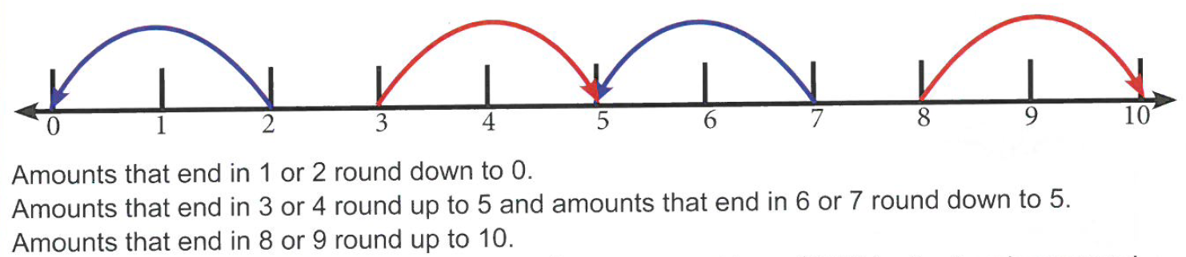
How do we round Money?

Slide 3
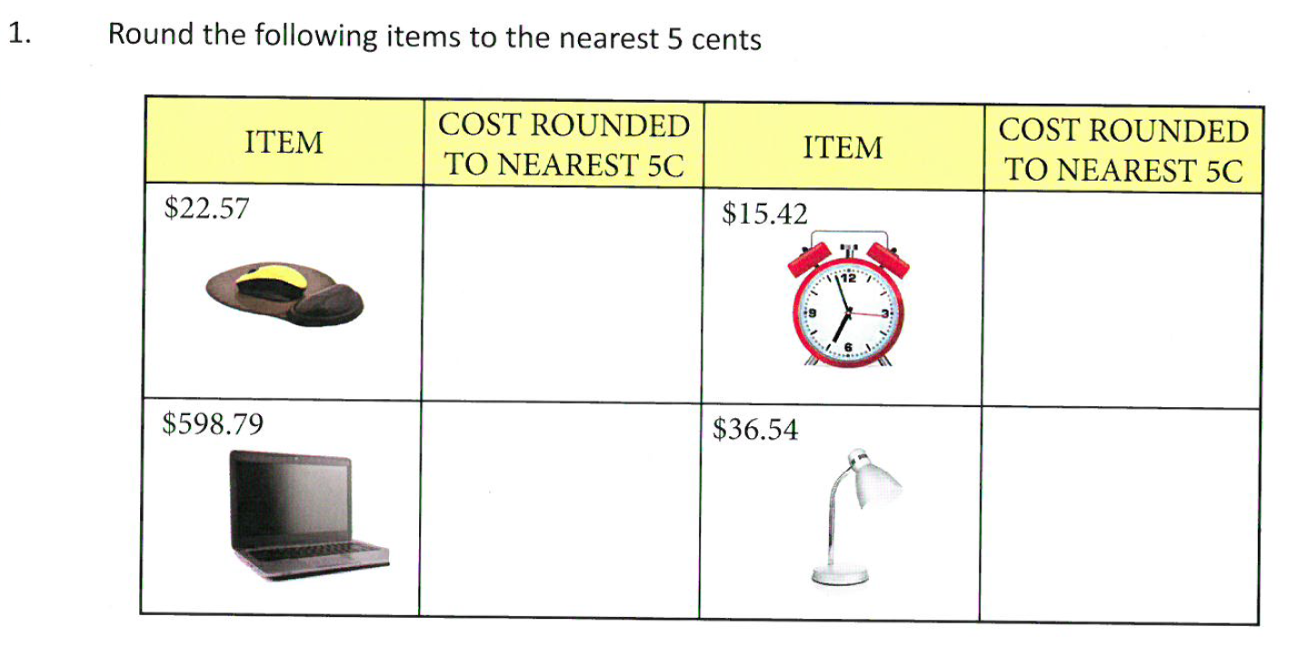
Practice

Slide 4
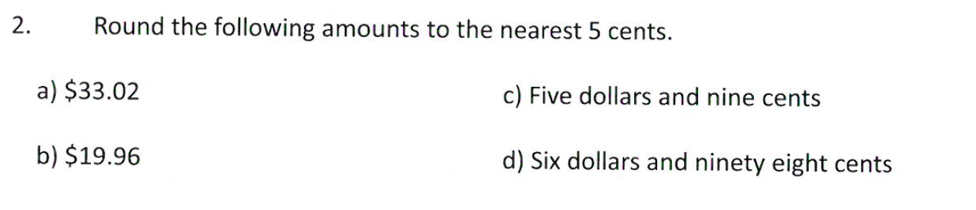
Practice

Slide 5
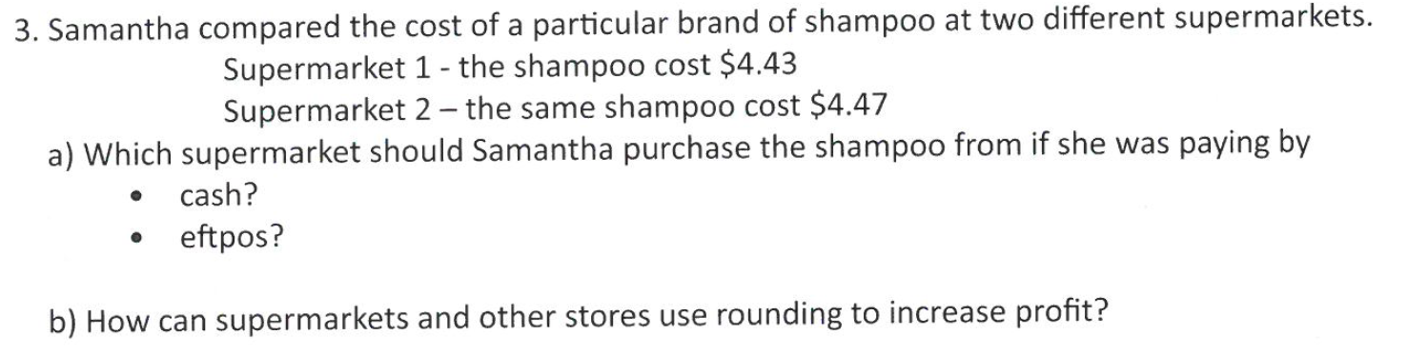

Slide 6
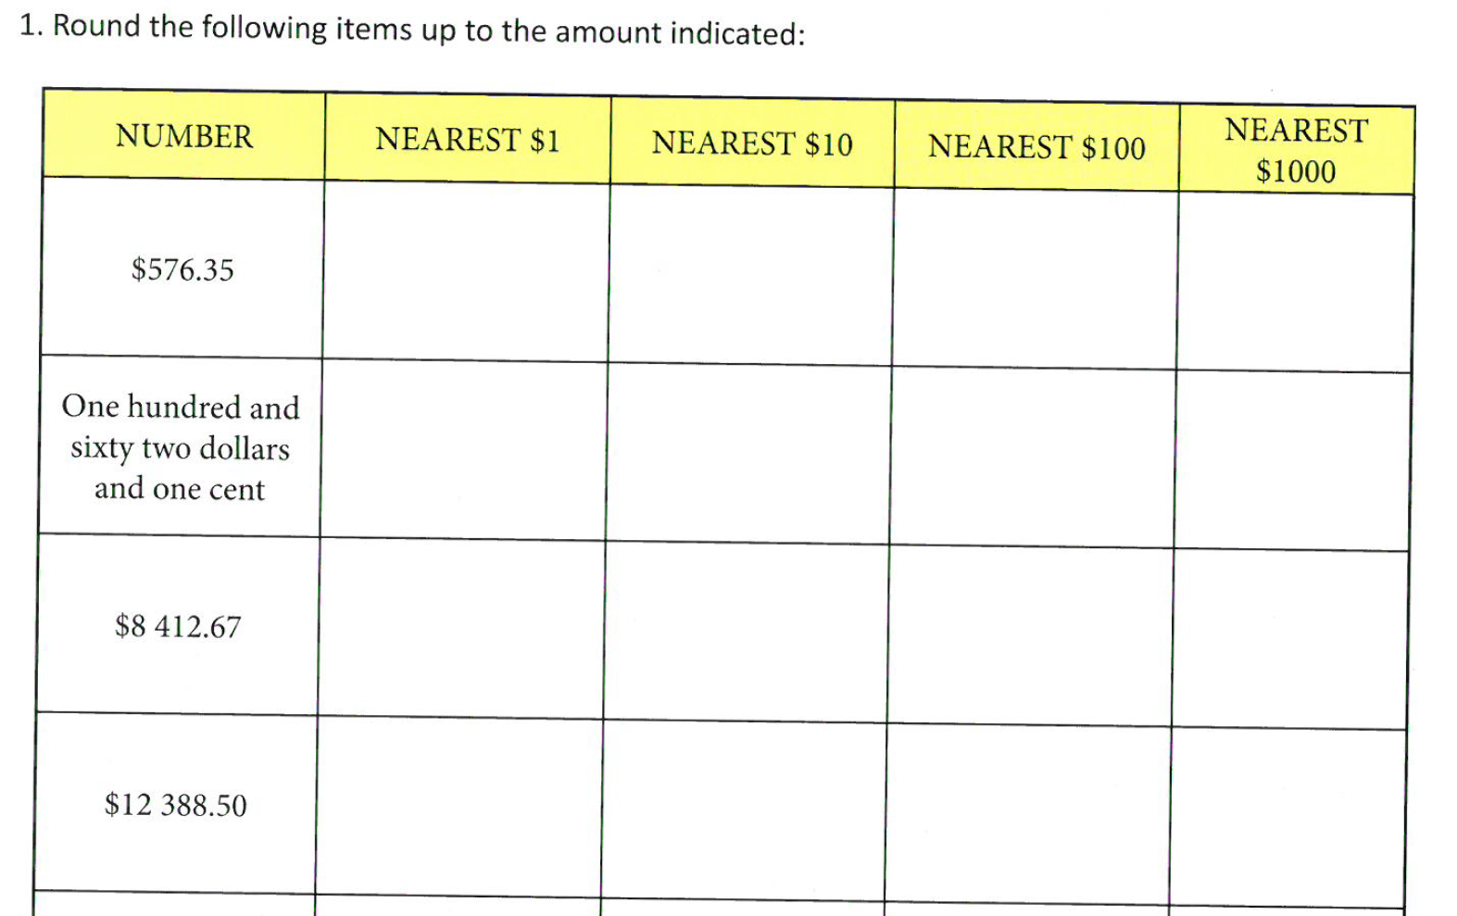

Slide 7
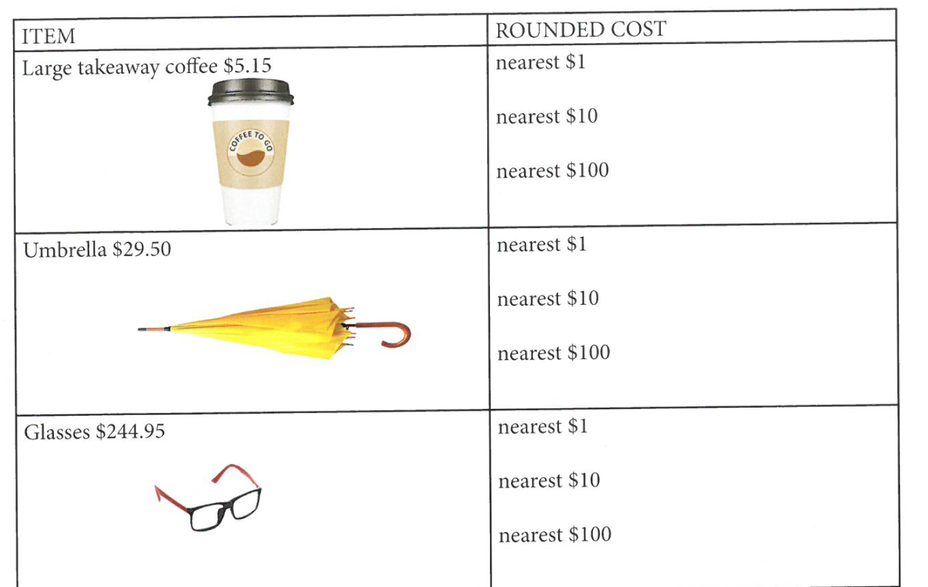

Slide 8
